Slide 1
Course Sections | Number of Lectures | HW Due (Canvas) | Test (Honor-lock) | Section in Course Packet | Chapter/Sections in Text (FOL)
5. Calculation of lightning electromagnetic fields | 4 | HW6 04/14 | T6 04/16 | 5 | 5, App. 3
6. Modeling of lightning processes | 3 |  |  | 6 | 6
7. Measurements of lightning electric and magnetic fields | 2 |  |  | 7 | 7
8. Lightning locating systems and lightning protection | 2 | - | - | 8,9 | 8,9
Review | 1 |  |  | 1-9 | 1-9, App. 1-4
Final Exam (via Honorlock) | - | - | Apr. 28 (W) 12:30-2:30 p.m. | 1-9 | 1-9, App. 1-4

Slide 2
E-field measuring system (capacitive antenna, C discharges through R_{in})
Norton equivalent circuit of electric field antenna shown along with the integrating capacitance and the input impedance of recorder (usually C>>C_{a} and C>>C_{in}). Drawing by Potao Sun.
V_{out} = (ε₀AE/C) if R_{in} >> 1/(ωC

Slide 3
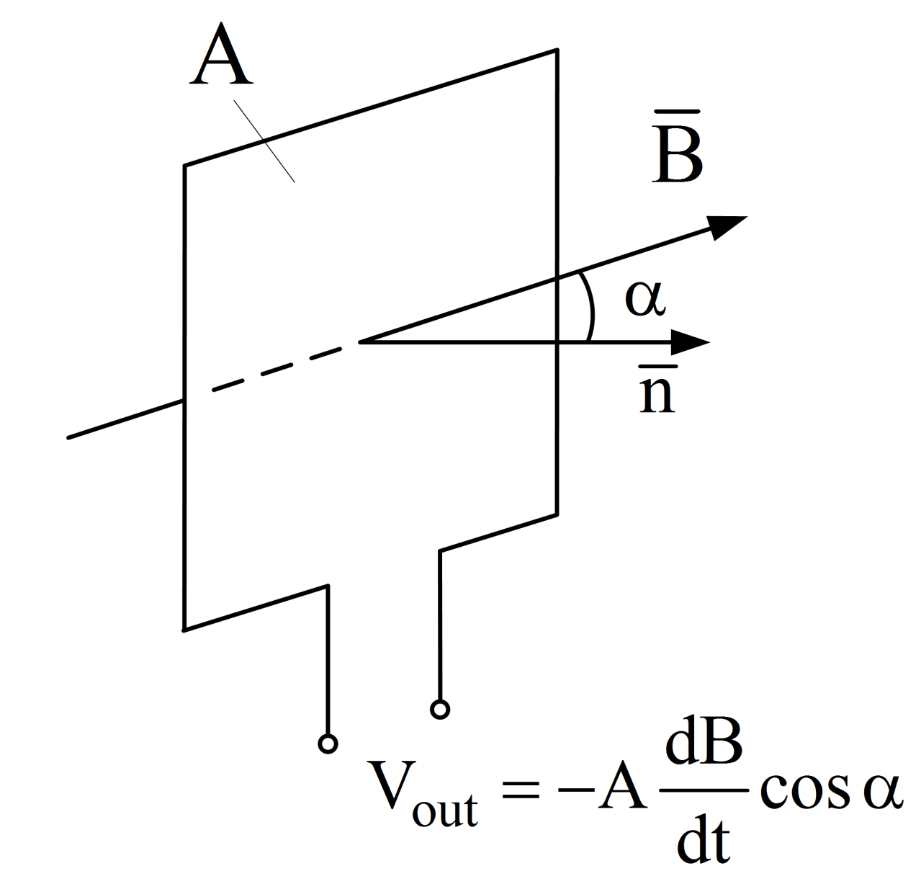
Illustration of the principle of operation of the loop antenna. Drawing by Potao Sun.

Slide 4
(B = B_{n})
Thevenin equivalent circuit of magnetic field antenna shown along with the integrating circuit and the input impedance of recorder (C>>C_{in}).
V_{out} = AB_{n}/(RC), if the following 3 conditions are met:
R >> ωL (ω << R/L, upper frequency response),
R_{in} >> R (C discharges through R, not R_{in}), and
3) R >> 1/(ωC) (ω >> 1/(RC), lower frequency response).

Slide 5

Lightning Locating Systems
5
Notes:
5

Slide 6
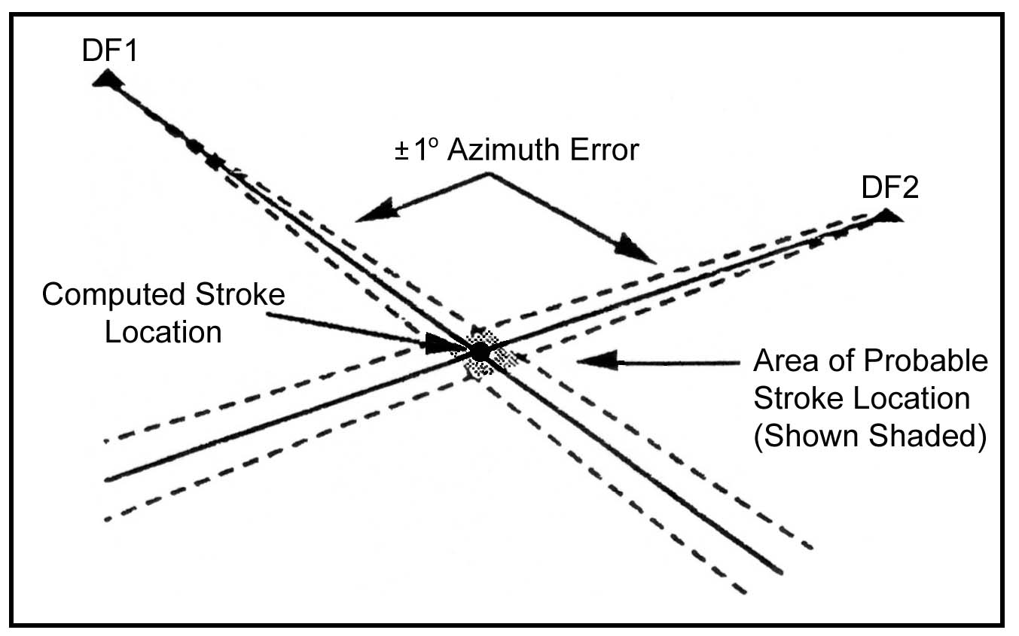
Wideband magnetic direction finding (MDF)
Determination of lightning stroke location when only two direction finders (DFs) detect the stroke. The solid lines represent the measured azimuths to the stroke; the broken lines represent the +1º angular random error in the azimuth measurements (polarization error). The solid circle indicates the computed stroke location; the shaded region indicates the uncertainty in location of the stroke. Adapted from Holle and Lopez (1993).
6

Slide 7
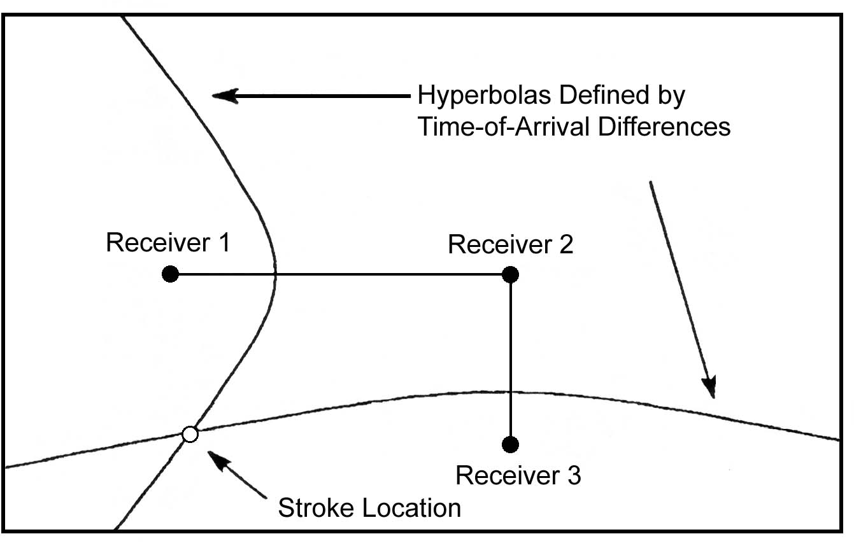
Long baseline time-of-arrival (TOA) technique
Determination of lightning stroke location by three TOA receivers when the solution is unique. Shown are two hyperbolas, defined by the TOA differences, that intersect to define the unique location of the stroke (open circle). Adapted from Holle and Lopez (1993). Long baseline systems generally operate at VLF and LF (3 to 300 kHz) and are used to identify the ground strike point or the “average” location of the flash.
7

Slide 8
Modern multiple-station regional
and global lightning locating
(detection) systems

Slide 9
Modern multiple-station regional lightning
detection (locating) systems
1). U.S. National Lightning Detection Network (NLDN), 400 Hz-400 kHz, combination of time-of-arrival (TOA) and magnetic direction
finding (MDF) techniques
2). Earth Networks (formerly WeatherBug) Total Lightning Network (ENTLN), 1 Hz-12 MHz, TOA
.
9

Slide 10
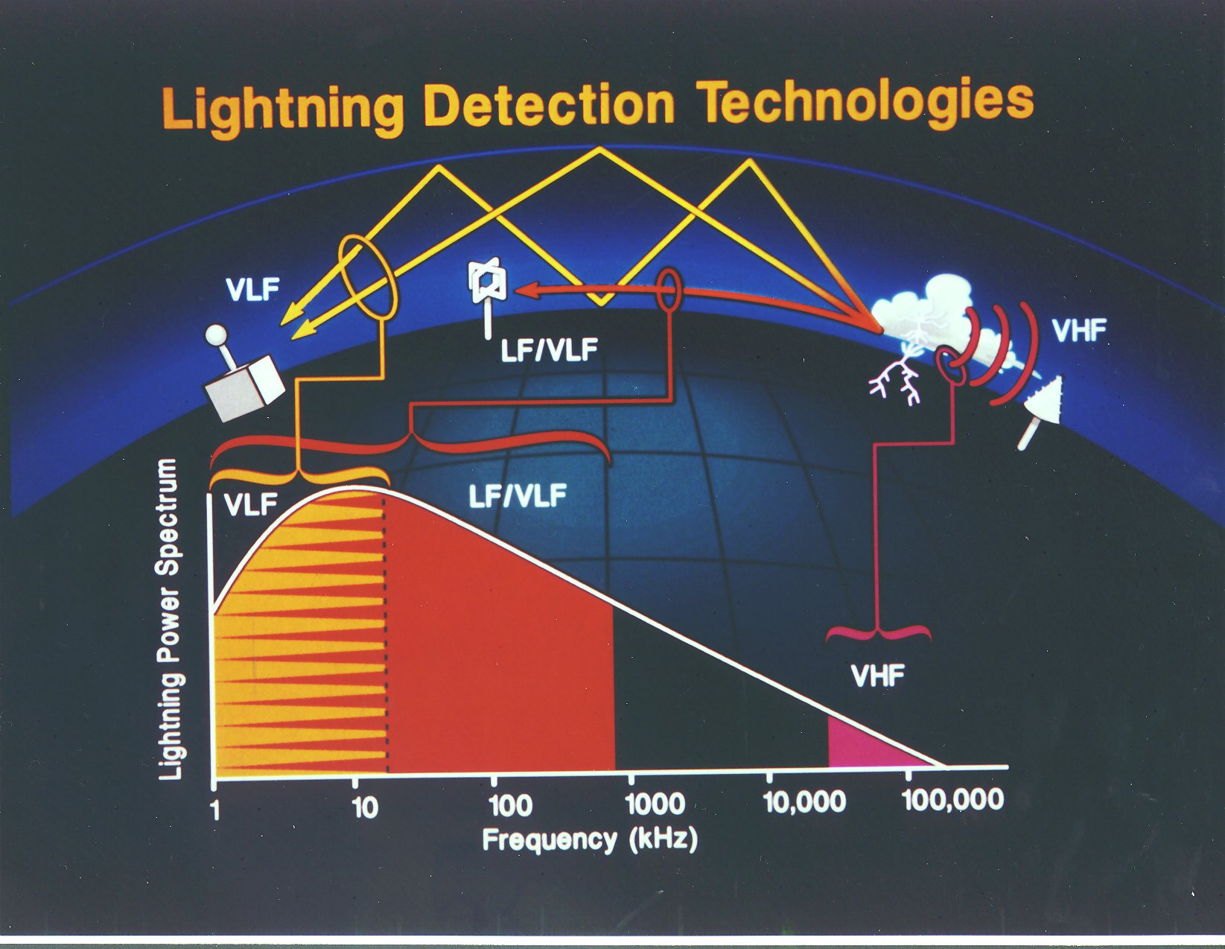
1000s of km
100s of km
Courtesy of Dr. K.L. Cummins and Vaisala
VLF: 3-30 kHz; LF: 30-300 kHz; VHF: 30-300 MHz
10

Slide 11
Modern multiple-station global lightning detection (locating) systems
3) World Wide Lightning Location Network (WWLLN), 6-18 kHz, time-of-group-arrival (TOGA) technique (based on the fact that lightning VLF signals propagating in the Earth-ionosphere waveguide experience dispersion, in that the higher-frequency components arrive earlier than the lower-frequency components).
4) Global Lightning Dataset (GLD360), 300 Hz – 48 kHz, combination of TOA, MDF, and waveform recognition algorithm (relies on the bank of “canonical” sferic waveforms for different ranges).

Slide 12
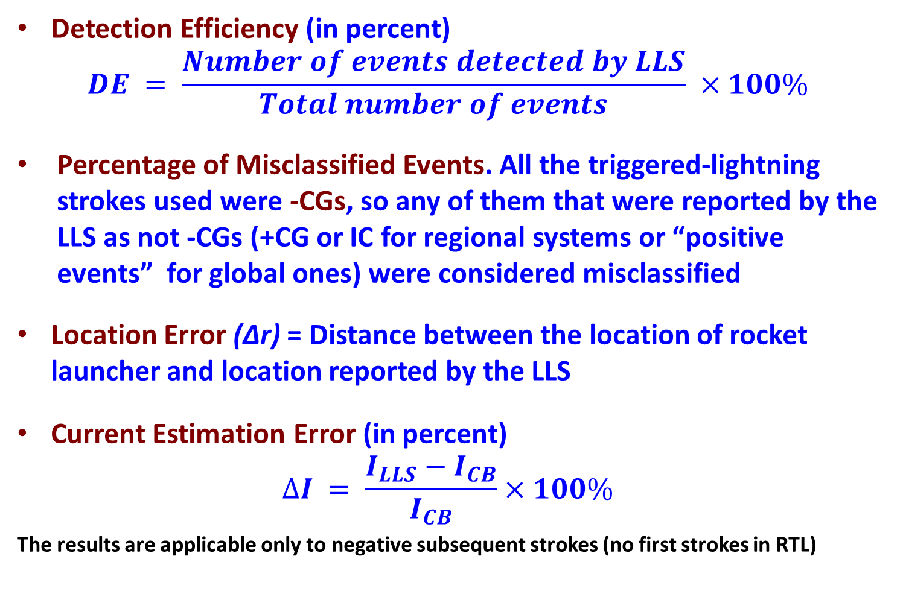
LLS Performance Characteristics (evaluated using RTL)
Detection Efficiency (in percent)
$$DE = \frac{Number of events detected by LLS}{Total number of events} ×100\%$$
Percentage of Misclassified Events. All the triggered-lightning strokes used were -CGs, so any of them that were reported by the LLS as not -CGs (+CG or IC for regional systems or “positive events” for global ones) were considered misclassified
Location Error (Δr) = Distance between the location of rocket launcher and location reported by the LLS
Current Estimation Error (in percent)
$$∆I = \frac{I_{LLS}−I_{CB}}{I_{CB}}×100\%$$
The results are applicable only to negative subsequent strokes (no first strokes in RTL)

Slide 13
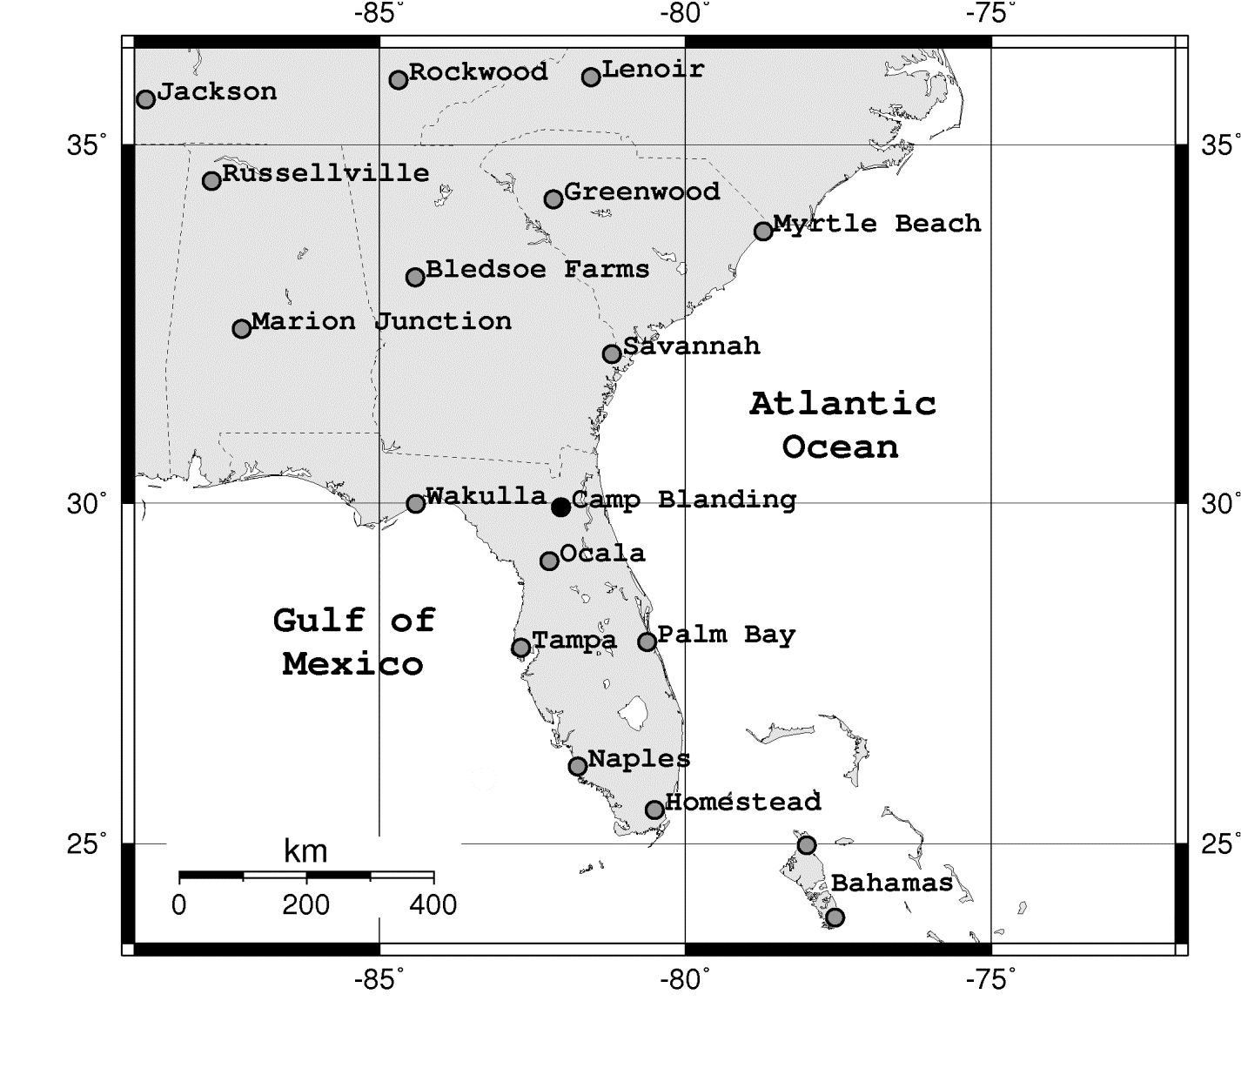
NLDN
The map shows the locations of 17 NLDN sensors in and around the Florida region as of 2012. The maximum number of sensors reporting CB events was 16. Adapted from Mallick et al. (2014).

Slide 14
NLDN performance characteristics in 2001-2015
(15 years, including 2 major upgrades completed in 2004 and 2013)
 | Jerauld et al. (2005) | Nag et al. (2011) | Mallick et al. (2014) | UF Group (2019)
Period | 2001 – 2003 (3 years) | 2004 – 2009 (5 years) | 2004 – 2013 (9 years) | 2014-2015 (2 years)
Flash Detection Efficiency | 84% (N = 37) | 92% (N = 37) | 94% (N = 90) | 100% (N = 36)
Stroke Detection Efficiency | 60% (N = 159) | 76% (N = 139) | 75% (N = 388) | 86% (N = 175)
Percentage of Misclassified Strokes | – | – | 3% (N = 292) | 5% (N = 150)
Median Location Error | 600 m (N = 95) | 308 m (N = 105) | 309 m (N = 292) | 162 m (N =150)
Median Absolute Current Estimation Error | 20% (N = 70) | 13% (N = 96) | 14% (N = 268) | 15% (N = 148)

Slide 15
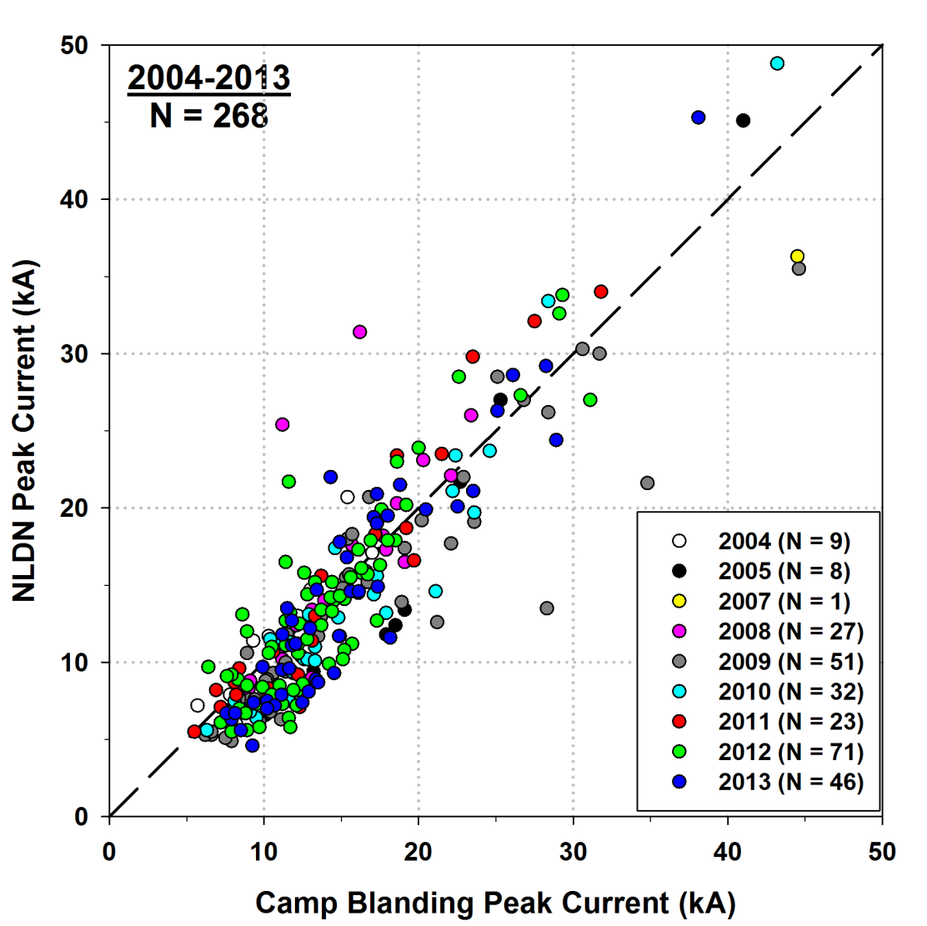
I_{NLDN} vs. I_{CB}
The slanted broken line (slope = 1) is the locus of the points for which the NLDN-reported peak currents and the directly-measured peak currents are equal. The NLDN tends to underestimate the peak current (by about 10%, on average).

Slide 16
NLDN locations with
50% error ellipses
The NLDN 50% error ellipse is calculated for each
stroke location and defined as a confidence region
for which there is a 50% probability that the actual
stroke location lies within the area circumscribed
by the ellipse, with the center of the ellipse being
the most probable (reported) stroke location.

Slide 17
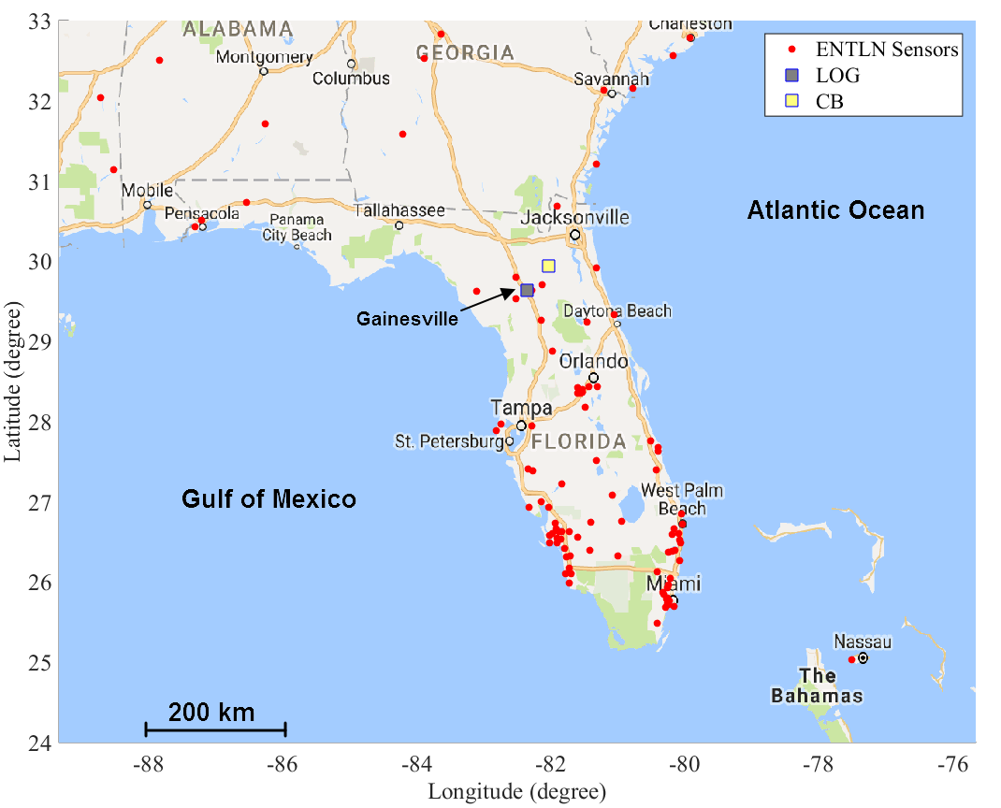
General information
The Earth Networks Total Lightning Network (ENTLN), formerly Weatherbug Total Lightning Network (WTLN), operates in the United States and in a number of other countries.
ENTLN
The map shows locations of ENTLN sensors (red circles) in and around the Florida region. The location of Camp Blanding (yellow square) is also shown. Evaluation was performed in 2014-2015. The number of ENTLN sensors shown in this figure is 84, with the total number of sensors in the contiguous United States being more than 900. Adapted from Zhu et al. [2017].

Slide 18
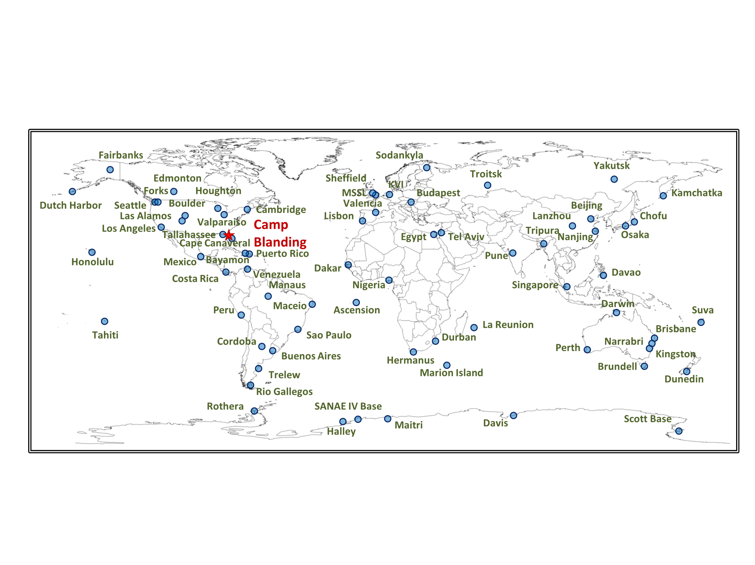
WWLLN
Map showing the locations of WWLLN sensors (blue circles) as of 2013. The number of sensors has grown from 18 in 2004 to 70 in 2013. Since April 15, 2009, stroke radiated energy is reported. The approximate location of Camp Blanding (red star) is also shown. Evaluation was performed in 2008-2013.

Slide 19
WWLLN performance characteristics
(RS and SIP). Adapted from Mallick et al. (2014)
 | 2008–2013
Flash Detection Efficiency | 8.8% (N = 80)
Stroke Detection Efficiency | 2.5% (N = 360)
Stroke Detection Efficiency (for I_{p} >25 kA) | 29% (N = 21)
Median Location Error | 2.1 km (N = 10)
Median Absolute Event-Time Mismatch | 15.3 µs (N = 7)
Median Absolute Peak Current Estimation Error | 30% (N = 7)

Slide 20
GLD360 Performance Characteristics (RS only) Adapted from Mallick et al. (2014)
 | 2011 | 2012 | 2013 | 2011–2013
Flash Detection Efficiency | 55% (N = 11) | 58% (N = 19) | 92% (N = 12) | 67% (N = 42)
Stroke Detection Efficiency | 29% (N = 38) | 31% (N = 101) | 53% (N = 62) | 37% (N = 201)
Percentage of Misclassified Strokes | 0% (N = 11) | 3% (N = 31) | 0% (N = 33) | 1.3% (N = 75)
Median Location Error | 4.7 km (N = 11) | 1.9 km (N = 31) | 1.9 km (N = 33) | 2.1 km (N = 75)
Median Absolute Current Estimation Error | 41% (N = 11) | 16% (N = 31) | 29% (N = 32) | 27% (N = 74)

Slide 21
Concluding remarks
Regional LLSs allow one to achieve location errors as low as a few hundreds of meters and flash detection efficiencies exceeding 90%.
Global LLSs presently cannot distinguish between ICs and CGs. Detection efficiency of WWLLN is low.
Rocket-triggered lightning can be used for calibrating LLSs, although the results are applicable only to subsequent strokes in negative lightning.
Natural-lightning data can be used for estimating DE and CA for both CG and IC events, but generally cannot be used for estimating LA and peak-current errors.
21

Slide 22
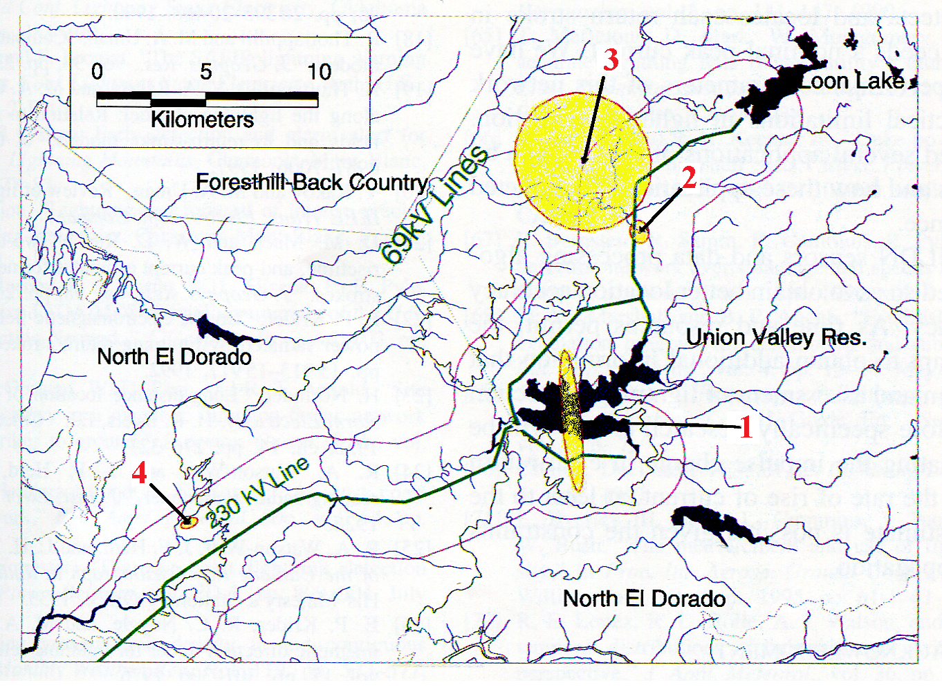
Lightning protection studies (Sacramento Municipal Utility District)
Originally, 24 faults (in 2 years) were suspected to be due to lightning strokes. Only for 4 of them NLDN reported strokes located sufficiently close to the power lines (strokes 1-3 were near 69-kV lines and stroke 4 was near a 230-kV line). The 50% location error ellipses for strokes 1-4 are shown in yellow. Adapted from Cummins et al. (1998).
22
22
Notes:
22

Slide 23
Lightning Protection
23
Notes:
23

Slide 24
Course Sections | Number of Lectures | HW Due (Canvas) | Test (Honor-lock) | Section in Course Packet | Chapter/Sections in Text (FOL)
5. Calculation of lightning electromagnetic fields | 4 | HW6 04/14 | T6 04/16 | 5 | 5, App. 3
6. Modeling of lightning processes | 3 |  |  | 6 | 6
7. Measurements of lightning electric and magnetic fields | 2 |  |  | 7 | 7
8. Lightning locating systems and lightning protection | 2 | - | - | 8,9 | 8,9
Review | 1 |  |  | 1-9 | 1-9, App. 1-4
Final Exam (via Honorlock) | - | - | Apr. 28 (W) 12:30-2:30 p.m. | 1-9 | 1-9, App. 1-4

Slide 25
Lightning Parameters vs. Damage Mechanisms
The type and amount of lightning damage that an object suffers depends on both the characteristics of the lightning discharge and the properties of the object.
Four distinct parameters derivable from the lightning current waveform are considered important in producing damage:
  the peak current,
  the maximum rate of change of current (dI/dt),
  the integral of the current over time (charge transfer), and
  the integral of the current squared over time (specific energy or action integral).
25
Notes:
25

Slide 26
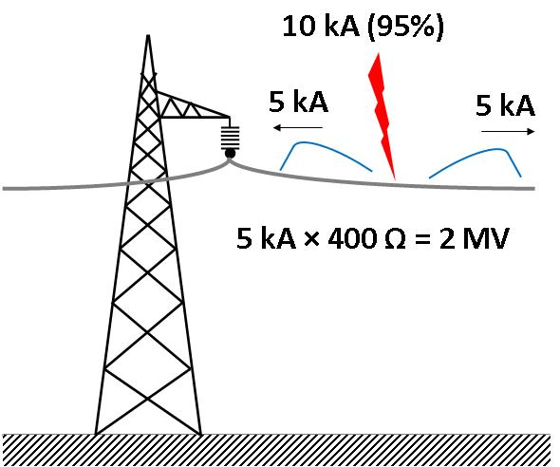
Lightning Parameters vs. Damage Mechanisms
Peak current. For objects or systems that present an essentially resistive impedance, such as, under certain conditions, a ground rod, a power line, and a tree, the voltage (V) on the object or system with respect to remote ground will be proportional to the current, I, via Ohm's law, V = RI, where R is the effective resistance at the strike point. For example, a 10 kA peak current injected into a power line conductor with a 400 Ω characteristic impedance produces a line voltage of 2 MV with respect to the earth.
Such a large voltage will cause insulation flashover.
26

Slide 27
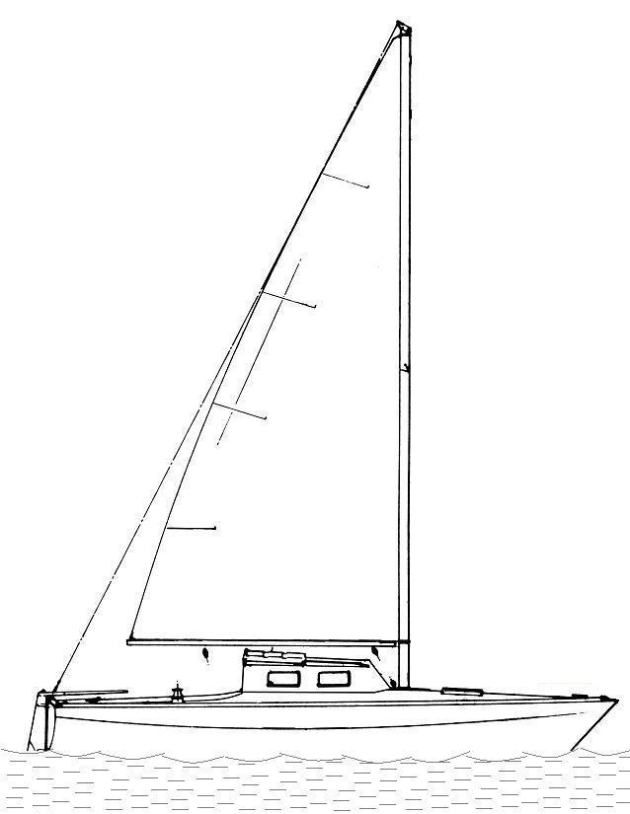
Lightning Parameters vs. Damage Mechanisms
dI/dt = 100 kA/µs
Maximum rate-of-change of current (dI/dt)
Lightning induced effects are often related to dI/dt
According to Faraday’s Law:
r = 2 m
Area A
(for A = 1 m²)
H = I/2πr (Ampere’s law)
dH/dt = (dI/dt)/2πr
dB/dt = μ₀(dH/dt)
= μ₀(dI/dt)/2πr
For A = (10 × 10) cm² , V = 100 V
27
Notes:
27

Slide 28
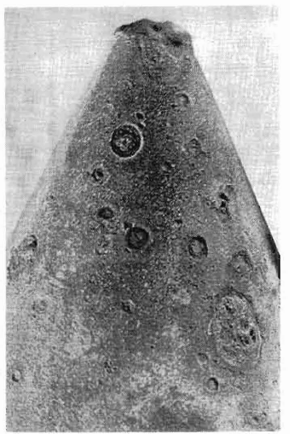
Examples of lightning damage – melting effect (related to charge transfer)
The severity of heating or burn-through of metal sheets such as airplane wings and metal roofs is, to a first approximation, proportional to the charge transferred to the metallic surface by the lightning arc channel. Generally, large charge transfers are due to long (tens to hundreds of milliseconds) continuing currents, whose magnitude is in the 100- to 1,000-A range, rather than impulsive currents having larger amplitudes but relatively short durations and hence producing relatively small charge transfers.
Lightning damage to the steel tip of the Ostankino Television Tower in Moscow, Russia. Adapted from Bazelyan and Raizer [2000].
28
Notes:
28

Slide 29
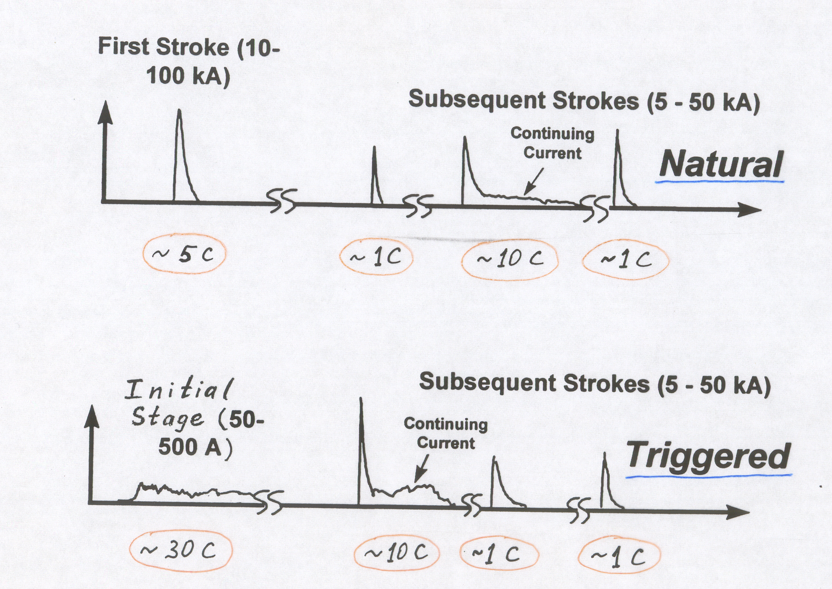

Natural Lightning vs. Rocket-Triggered Lightning
Natural
~ 5 C
~ 1 C
~ 10 C
~ 1 C
Initial Stage (50 – 500 A)
Triggered
~ 30 C
~ 10 C
~ 1 C
~ 1 C
29

Slide 30
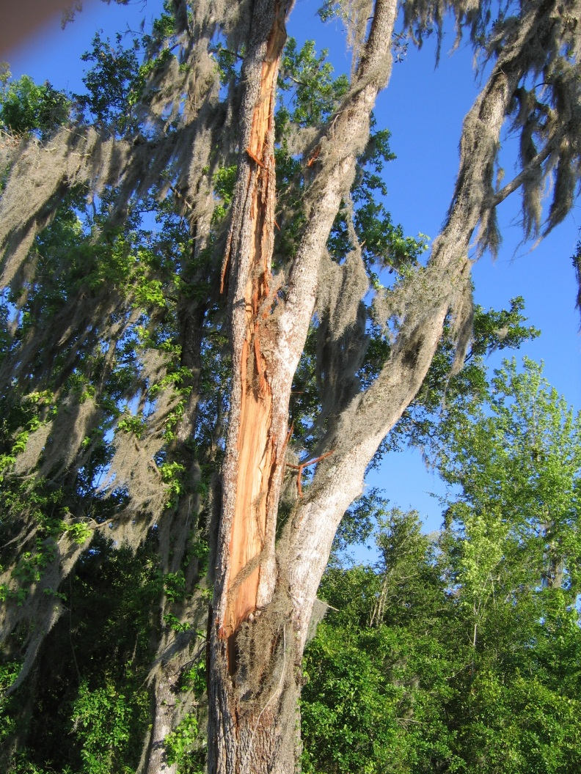
Examples of lightning damage – explosive effect (related to action integral)
The heating and melting of resistive current-carrying materials and the explosion of poorly conducting materials are, to a first approximation, related to the value of the time integral of the Joule heating power I²(t) R. For the case that R = 1 Ω, this integral is referred as the action integral or specific energy.
In the case of most poorly conducting materials, lightning-generated heat vaporizes the internal material and the resultant gas pressure causes an explosive effect.
Damage to an oak tree struck by lightning on March 29, 2009 in Gainesville, Florida. Photograph by Christopher Hayes.
30
Notes:
30

Slide 31
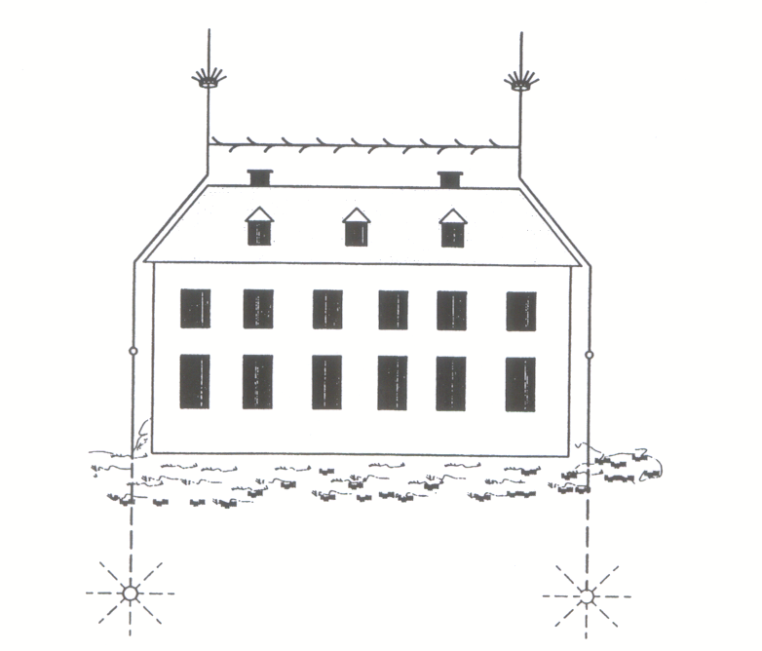
General Principles – Franklin Rod System (first described in 1753)
Air terminal
Down conductor
Ground terminal
Lightning protection system for houses proposed (most likely by G. Ch. Lichtenberg) in 1778. Adapted from Wiesinger and Zischank (1995).
31
Notes:
31

Slide 32
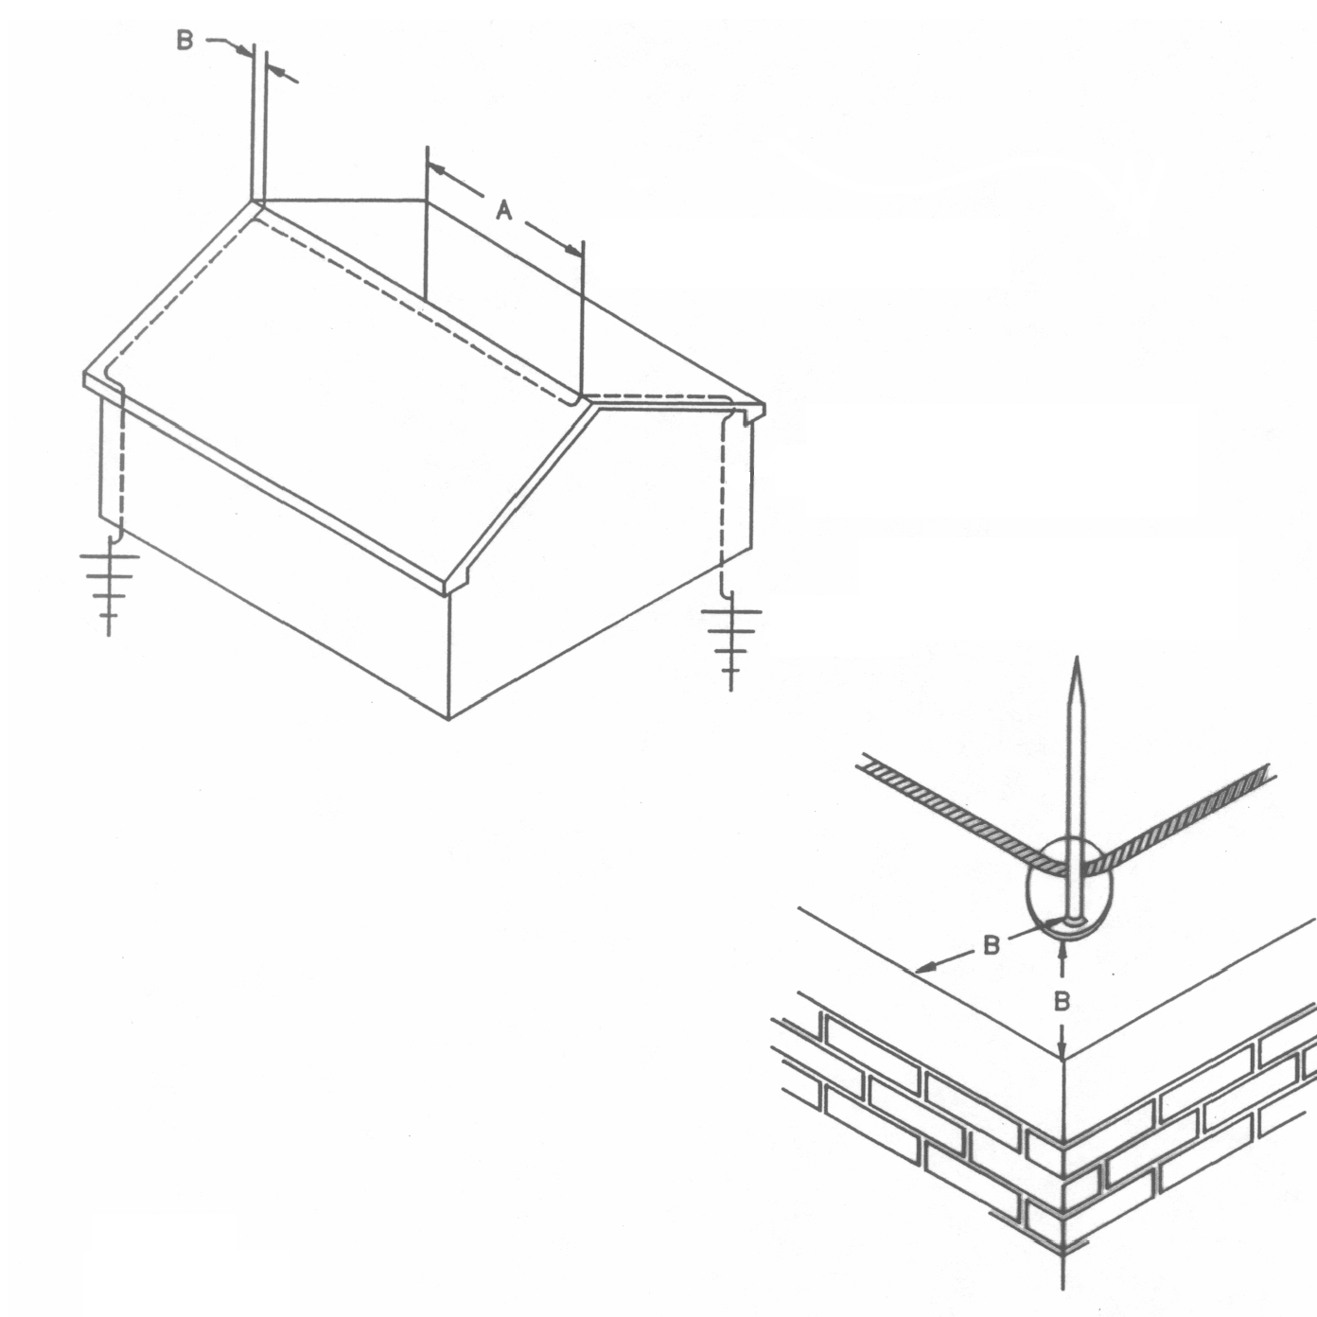
General Principles – Franklin Rod System
Air terminal locations (UL 96A, Fig. 6.2, 1998)
Air terminal
Down conductor
A= 20 feet (6 m) maximum spacing for 10 inch (25 cm) air terminal height or 25 feet (7.6 m) maximum spacing for 24 inch (61 cm) air terminal height.
B= 2 feet (61 cm) maximum spacing from corner, roof edge or ridge end.
Ground terminal
Metallic roofs whose thickness is 4.8 mm (3/16 in.) or greater do not require air terminals (NFPA 780).
32
Notes:
32

Slide 33
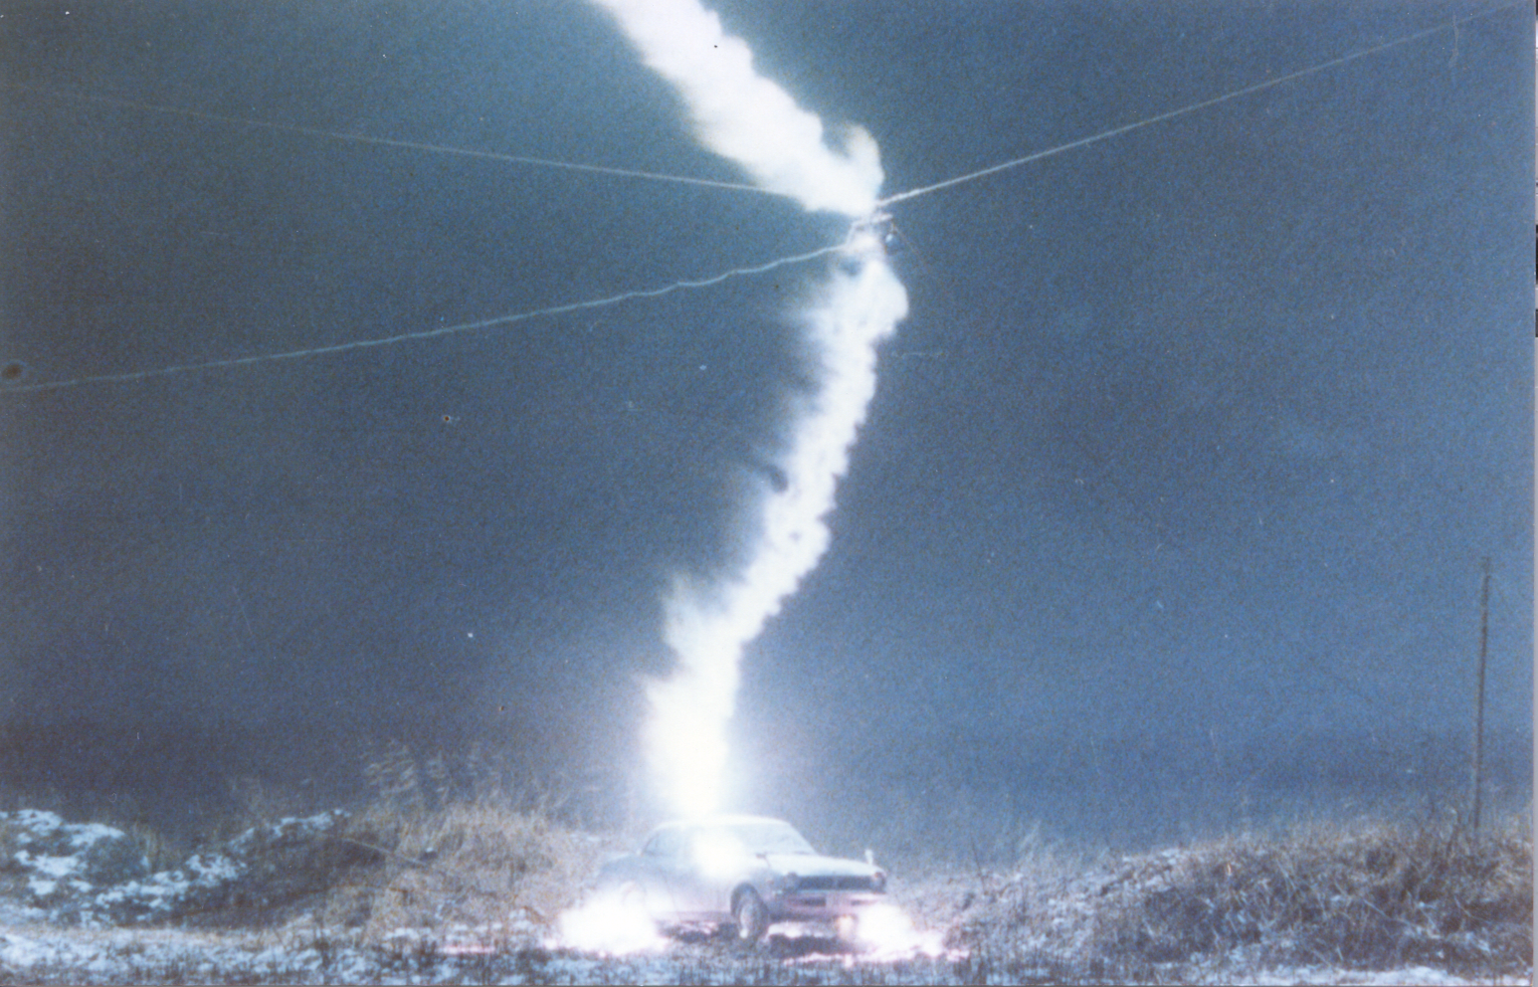
General Principles – “Faraday Cage” Approach
Lightning strike to a car with a live rabbit inside. Courtesy of S. Sumi.
33
Notes:
33

Slide 34
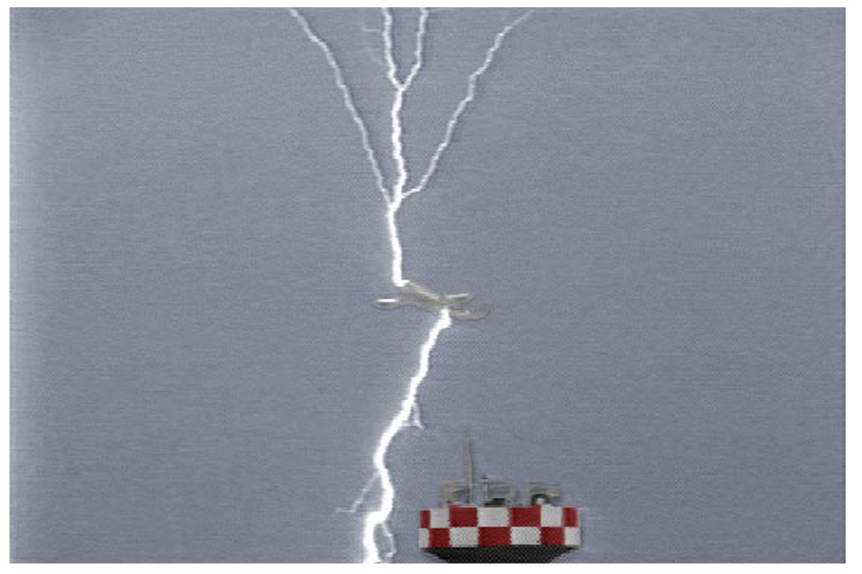
General Principles – “Faraday Cage” Approach
Video frame of a lightning strike to an aircraft on takeoff from the Kamatsu Air Force Base, Japan, during winter. Courtesy of Z. I. Kawasaki.
34
Notes:
34

Slide 35
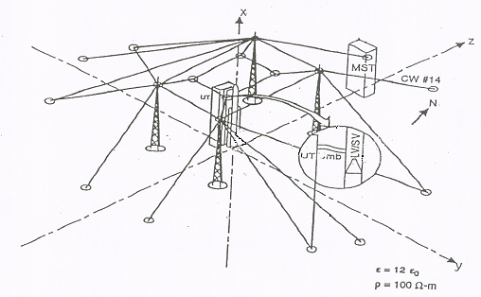

General Principles – “Faraday Cage” Approach
Cape Canaveral Air Force Station, Launch Pads 40/41. Nine grounding points. Courtesy of R. Kithil.
35
Notes:
35

Slide 36
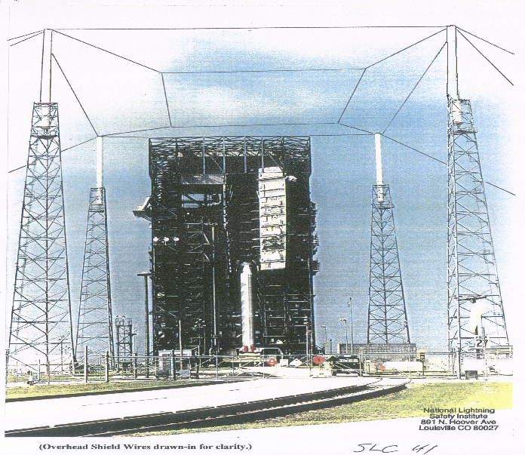
General Principles – “Faraday Cage” Approach
Cape Canaveral Air Force Station, Launch Pad 41. Courtesy of R. Kithil.
36
Notes:
36

Slide 37
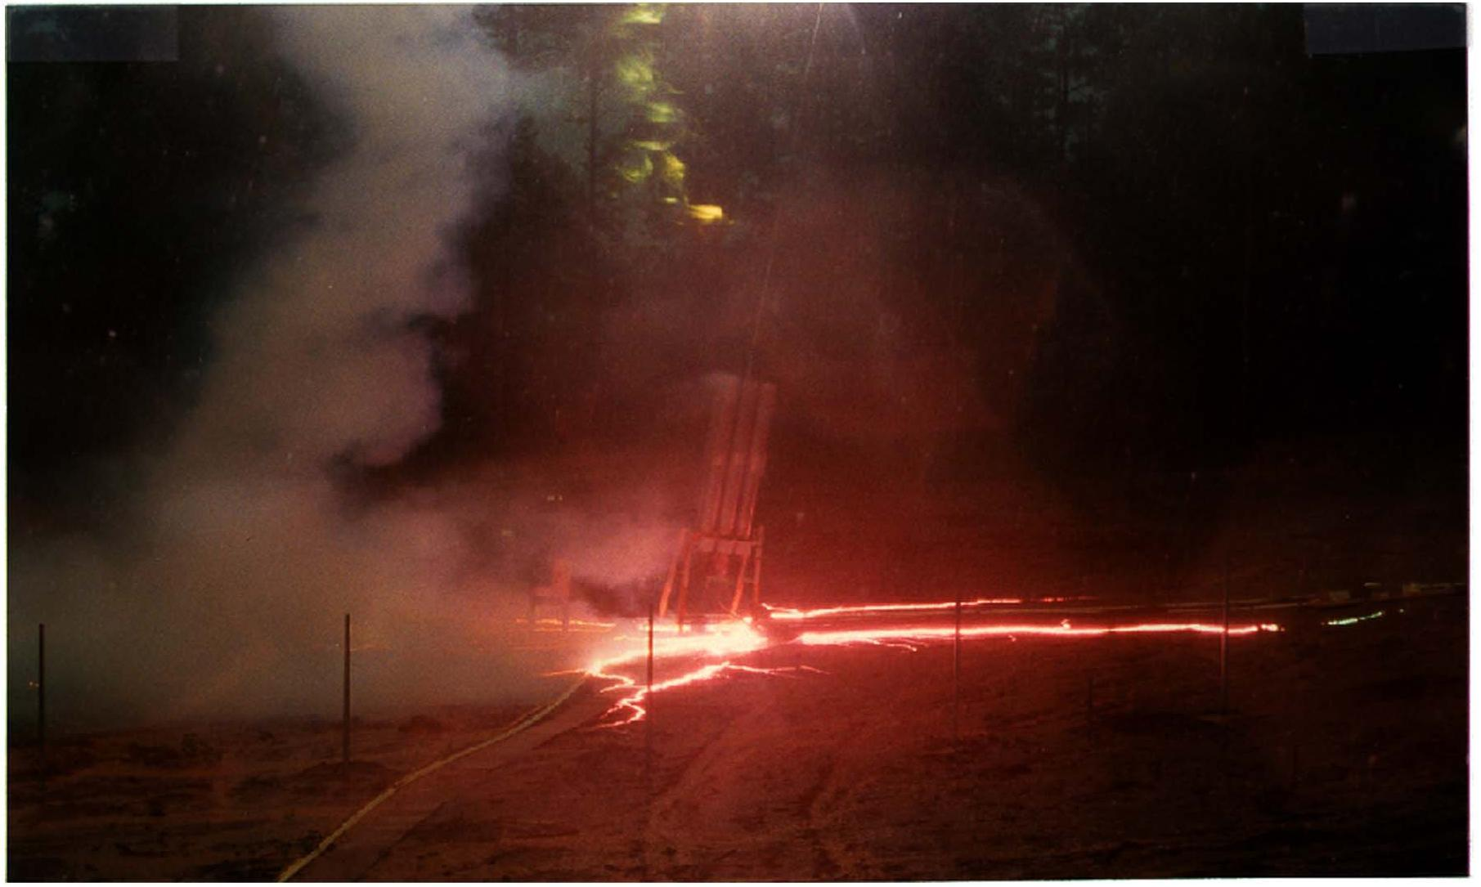
Bonding vs. Isolating Approaches in Lightning Protection Practice
10 m
Photograph of surface arcing associated with the second stroke (current peak I = 30 kA) of flash 9312 triggered at Fort McClellan, Alabama (R_{g} = 260 Ω) . The lightning channel is outside the field of view. One of the surface arcs approached the right edge of the photograph, a distance of 10 m from the rocket launcher. Adapted from Fisher et al. (1994). V = I x R_{g} = 7.8 MV (enough to produce a sideflash of more than 7 m in air).
37
Notes:
37

Slide 38
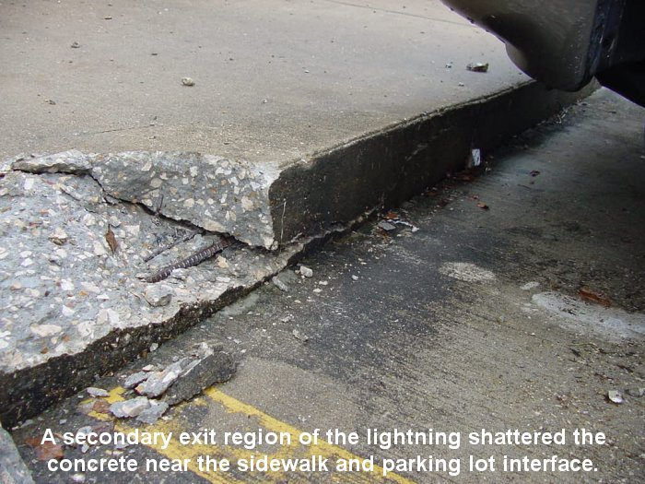
Bonding vs. Isolating Approaches in Lightning Protection Practice
Once arcing takes place, an unplanned and uncontrolled current path is created. The arc is likely to turn moisture in the soil or structural material to steam with potentially damaging hydrodynamic effects.
38
Notes:
38

Slide 39
Bonding vs. Isolating Approaches in Lightning Protection Practice
Destructive arcing between exposed or buried elements of the lightning protective system (LPS) and nearby metallic objects can be prevented by either
equipotential bonding or
adequate electrical isolation.
39
Notes:
39

Slide 40
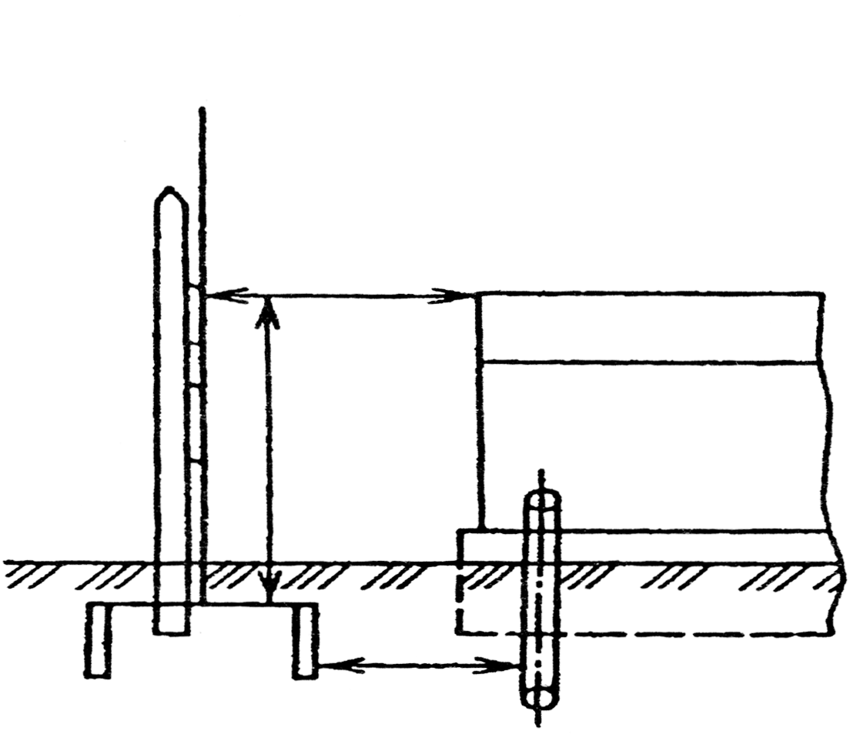
Bonding vs. Isolating Approaches in Lightning Protection Practice
D_{soil} = I Z_{g}/ E_{b}
If I = 60 kA, Z_{g} = 25 Ω and E_{b}= 300 kV/m, D_{soil} = 5 m
D_{air} = 0.12Z_{g}+0.1ℓ
LPS air terminal
D_{air}
I = the lightning peak current
Z_{g} = the grounding impedance
E_{b} = the breakdown electric field in
the soil
LPS down conductor
Wooden pole
ℓ
Protected Object
LPS grounding
system
D_{soil}
Buried Services
Bond whenever you cannot adequately isolate
Illustration of safety distances in the soil (D_{soil}) and in air (D_{air}).
Adapted from Kuzhekin et al. (2003).
40
Notes:
40

Slide 41
Bonding vs. Isolating Approaches in Lightning Protection Practice
The twofold objective of structural lightning protection is
to intercept imminent lightning strikes and force the current flow where one wants it to go (via Franklin LPS) and
not to allow the development of hazardous potential differences causing sideflashes or arcing (via equipotential bonding).
A difference of potential of 2 MV is sufficient for a sideflash of over 1.8 m in air (NFPA 780) or arcing through the soil over 5.4 m or so.
41
Notes:
41

Slide 42
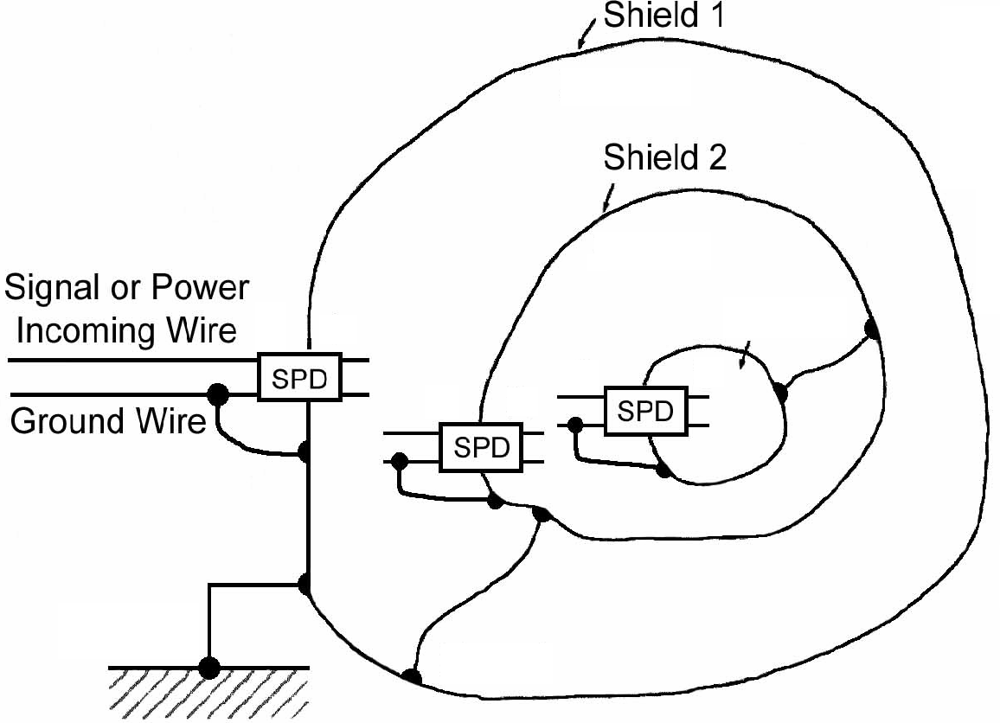
General Principles – “Faraday Cage” Approach
In 1876, James Clerk Maxwell proposed that a gunpowder building be completely enclosed with metal of sufficient thickness, forming what is now referred to as a Faraday cage.
If lightning were to strike a metal-enclosed building, the current would be constrained to the exterior of the metal enclosure, and it would not even be necessary to ground this enclosure. In the latter case, the lightning would merely produce an arc from the enclosure to earth.
The Faraday cage effect is provided by all-metal cars and airplanes. Modern steel-frame buildings with reinforcing metal bars in the concrete foundation connected to the building steel provide a good approximation to a Faraday cage.
Zone 1
Zone 2
0
1
Zone 3
2
3
1
2
Zone 0
Zone 1
SPD = Surge Protective Device
The general principles of topological
shielding. Adapted from Vance (1980)
42
Notes:
42

Slide 43
Lightning Locating Systems
(additional slides)
43
Notes:
43

Slide 44
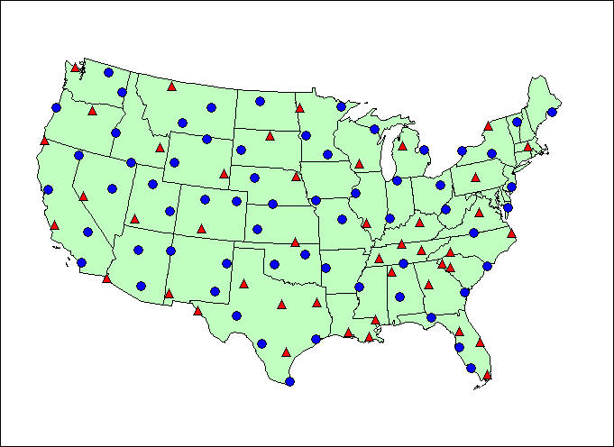
U.S. National Lightning Detection Network (2001)
47 IMPACT Sensors (red triangles); 59 LPATS/III Sensors (blue circles)
44
Notes:
44

Slide 45
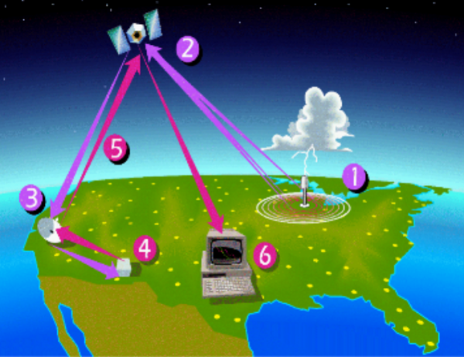
U.S. National Lightning Detection Network (NLDN)
Data flow in the U.S. National Lightning Detection Network (NLDN). Actual system employs three satellite downlink locations represented by item 3.
The NLDN has been providing real-time, continental-scale lightning data since 1989. The most recent network-wide NLDN upgrade was conducted in 2002-2004.
45

Slide 46
Correlated Stroke: Ellipse Confirms Structure Location
Ellipse Calculation

Slide 47
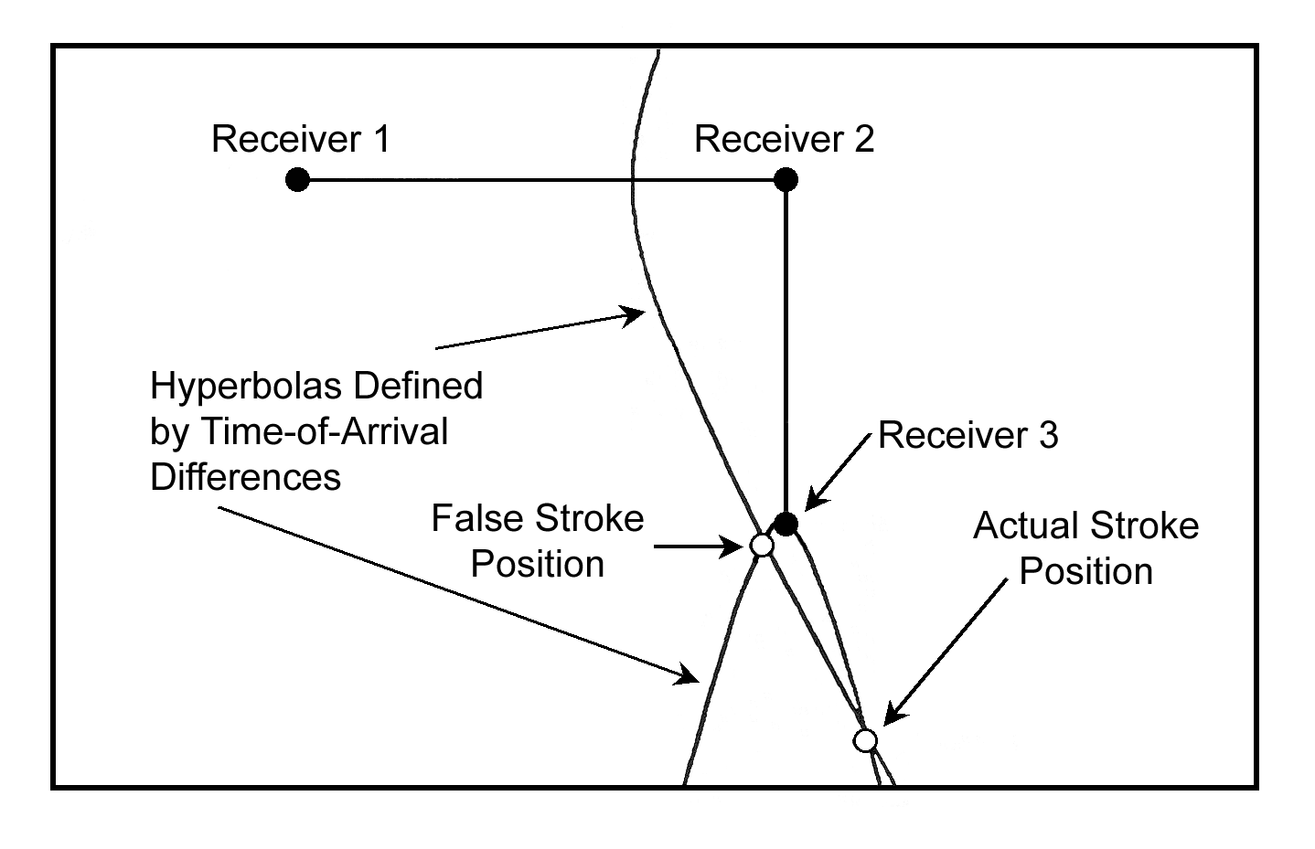
Determination of lightning stroke location by 3 TOA receivers when the solution is not unique. Shown are two hyperbolas that intersect at two points (open circles); one corresponds to the actual stroke position and the other is a false solution. Adapted from Holle and Lopez (1993).

Slide 48
1000s of km
100s of km
Courtesy of Dr. K.L. Cummins and Vaisala
VLF: 3-30 kHz; LF: 30-300 kHz; VHF: 30-300 MHz
48

Slide 49
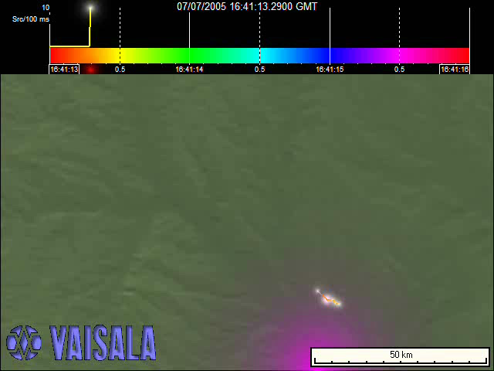
VHF Lightning Image - Animation
3 s
50 km
Courtesy of Dr. K.L. Cummins and Vaisala
49

Slide 50
LLS Performance Characteristics
Generally, a modern VLF-LF lightning locating system is expected to record (in separate categories) and locate over a certain area all or most of cloud-to-ground (CG) strokes of either polarity, as well as some cloud discharges.
Also expected for each discharge is a measure of its intensity, usually in the form of peak current inferred from measured electric or magnetic fields. Accordingly, system’s performance can be evaluated using the following characteristics:
(a) cloud-to-ground (CG) flash detection efficiency;
(b) CG stroke detection efficiency;
(c) cloud discharge detection efficiency;
(d) percentage of misclassified events;
(e) location accuracy (or location error);
(f) peak current estimation error;
(g) event-time mismatch.
50

Slide 51
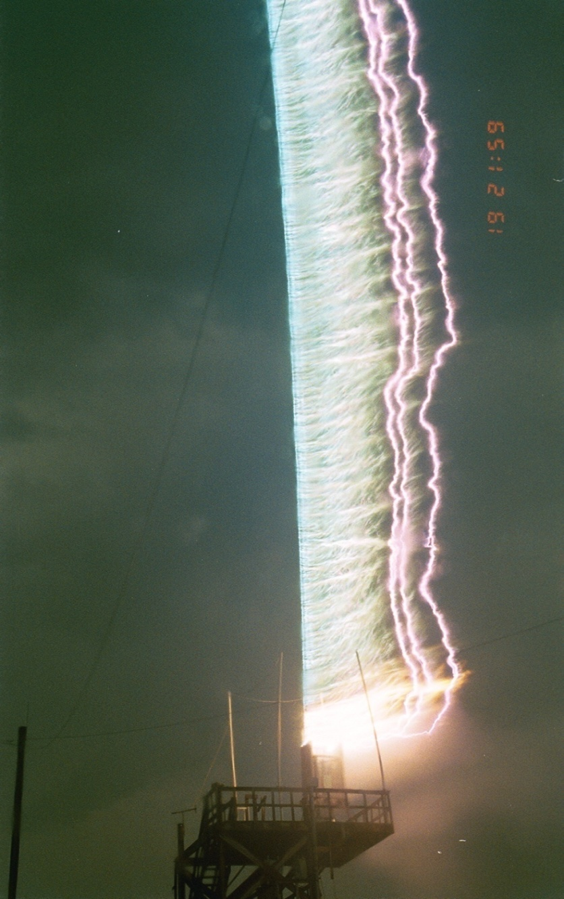
Rocket-Triggered Lightning at Camp Blanding
Exploded Wire
Return Stroke Channel
Launcher
Still picture (5-s exposure)
51

Slide 52
Natural Lightning vs. Rocket-Triggered Lightning
Natural
~ 5 C
~ 1 C
~ 10 C
~ 1 C
Initial Stage (50 – 500 A)
Triggered
~ 30 C
~ 10 C
~ 1 C
~ 1 C
52

Slide 53
Estimation of Lightning Peak Currents
by the NLDN
53

Slide 54
Methodology
The NLDN outputs a peak current estimate for each stroke using the measured magnetic radiation field peaks and distances to the ground strike point reported by multiple sensors. Initially (before1993), the following field-to-current conversion equation was used
where I is the peak current in kA and is the mean of range–normalized (to 100 km) signal strengths, RNSS, in LLP units, from all sensors allowed by the central analyzer to participate in the peak current estimate. Generally, it is required that D < 625 km.
The 0.2 conversion factor was obtained by Orville et al. [1987] by equating the observed median value of RNSS, based on reports of the SUNYA network (predecessor of the NLDN) in 1984-1985, to the median peak current of 30 kA directly-measured in Switzerland by Berger et al. [1975].
54

Slide 55
Methodology
Equation (implying that I ~ B) may be viewed as equivalent to the following equation derived for the transmission line model [Uman and McLain 1969] of the lightning return stroke.
(I ~ B/v)
where B is the magnetic radiation field at ground at a distance D from the lightning channel base, µ_{o} = 4π x 10⁻⁷ H/m is the permeability of free space, v is the return-stroke propagation speed, and c is the speed of light (3 x 10⁸ m/s), provided that D and v are known.
Note that v is not measured by the NLDN (or by any other LLS) and varies from stroke to stroke up to an order of magnitude [e.g., Rakov 2007], while equation implies that v is the same for all lightning strokes.
Later, rocket-triggered lightning data were used to calibrate the NLDN current estimation algorithm.
55

Slide 56
Evolution of the NLDN current estimation algorithm
Period | Before 1993 | 1993-1996 | 1996-2004 | 2004-present
Field-to-current conversion equation
Parameters of range normalization equation | b=1, L=10⁵ km | b=1.13, L=10⁵ km | b=1.13, L=10⁵ km | b=1, L=10³ km
Assumed distance dependence of signal strength | D⁻¹ | D^{-1.13} | D^{-1.13} | D⁻¹exp (-D/1000)
KSC
KSC/CB
Range normalization of signal strength, SS, to 100 km is done using the following equation:
56

Slide 57
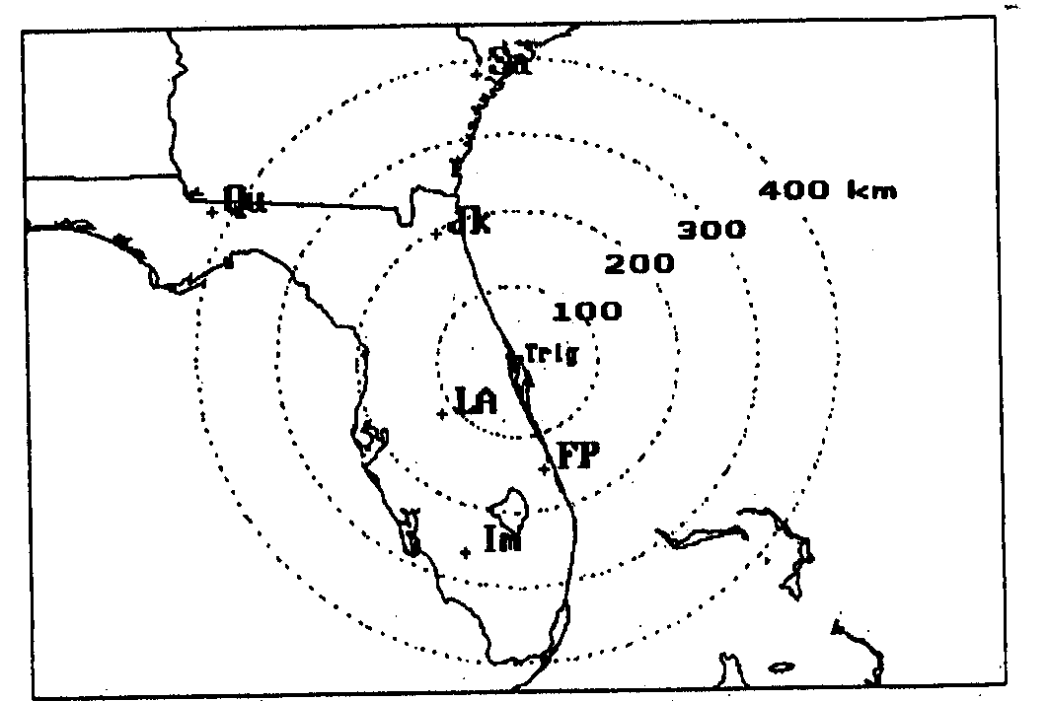
Triggered-lightning experiments at KSC, Florida (1985-1991)
Map showing the locations of six direction finders, data from which were used in studies of Orville [1991] and Idone et al. [1993]. One direction finder was located in Georgia, Sa (Savannah), and the remaining five were in Florida, Qu (Quincy), Jk (Jacksonville), LA (Lake Alfred), FP (Fort Pierce), and Im (Immokalee). Also shown is the location of lightning triggering site, labeled “Trig”, at the NASA Kennedy Space Center. Four dotted circles show distances, 100, 200, 300, and 400 km, from the triggering site. Adapted from Orville [1991].
57

Slide 58
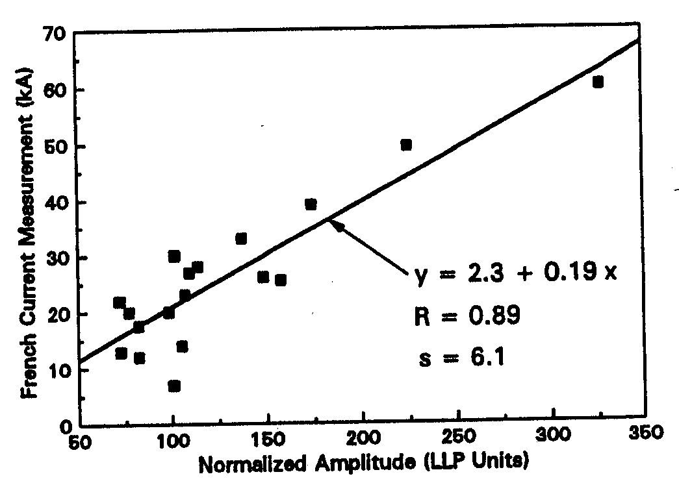
Triggered-lightning experiments at KSC, Florida (1985-1991)
y = 2.3 + 0.19 x
Directly measured peak current (labeled “French Current Measurement”) versus mean range normalized signal strength (RNSS, labeled “Normalized Amplitude”) for 18 strokes analyzed by Orville [1991]. Also given are the linear regression equation for the directly measured current (y) vs. RNSS (x), correlation coefficient (R) and standard deviation, (s, in kA), relative to the shown regression line. Adapted from Orville [1991].
58

Slide 59
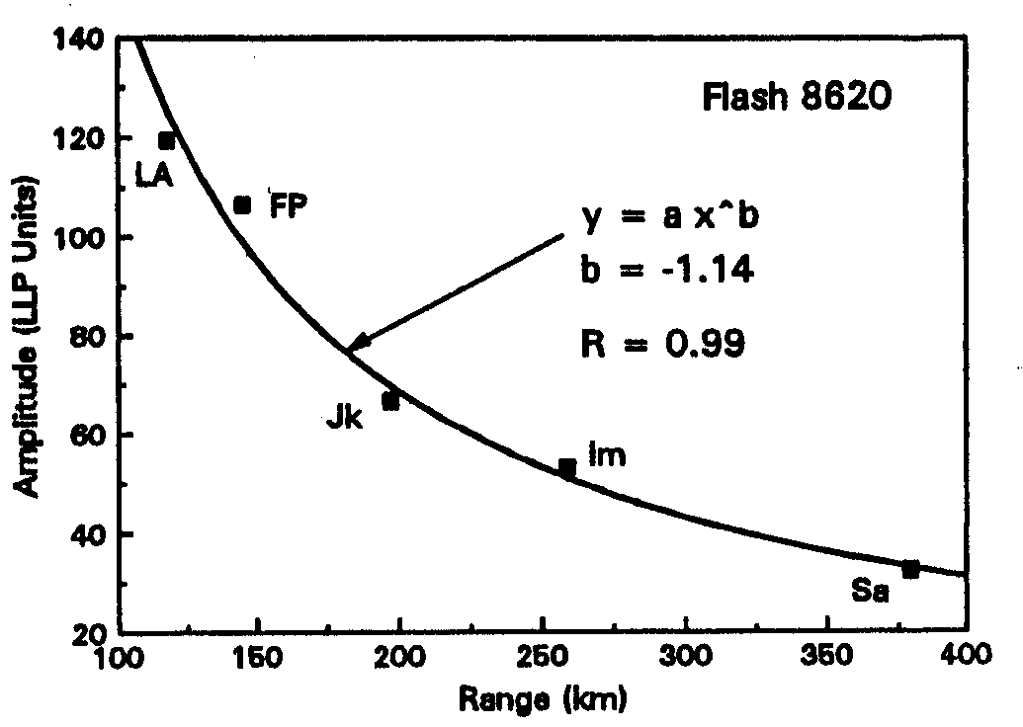
Triggered-lightning experiments at KSC, Florida (1985-1991)
Signal strengths (labeled “Amplitude”) reported by five direction finders, LA, FP, Jk, Im, and Sa, versus distance (labeled “Range”) from the lightning channel for Flash 8620, Stroke 1. Also given are the exponent (labeled “b”) of the shown best-fit power law curve and correlation coefficient, R. Adapted from Orville [1991].
The mean exponent for seven strokes was found to be -1.13.
59

